Slide 1
Single-Source Shortest Paths
Given: A single source vertex in a weighted, directed graph.
Want to compute a shortest path for each possible destination.
We will assume either
  no negative-weight edges, or
  no reachable negative-weight cycles.
Algorithm will compute a shortest-path tree.

Slide 2
Dijkstra’s Algorithm
“Shortest path from one node to all other nodes in which weights are none-negative”

Slide 3


Slide 4


Slide 5


Slide 6


Slide 7


Slide 8


Slide 9
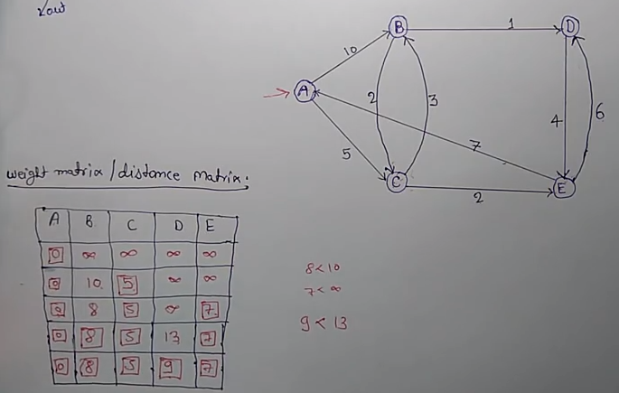

Slide 10

Assumes no negative-weight edges.
Maintains a set S of vertices whose SP from s has been determined.
Repeatedly selects u in V–S with minimum SP estimate (greedy choice).
Store V–S in priority queue Q.
Initialize(G, s);
S := ∅;
Q := V[G];
while Q ≠ ∅ do
u := Extract-Min(Q);
S := S ∪ {u};
for each v ∈ Adj[u] do
Relax(u, v, w)
od
od

Slide 11

u
v
∞
1
∞
10
9
2
3
s
0
4
6
5
7
∞
∞
2
x
y

Slide 12
u
v
10
1
∞
10
9
2
3
s
0
4
6
5
7
5
∞
2
x
y

Slide 13
u
v
8
1
14
10
9
2
3
s
0
4
6
5
7
5
7
2
x
y

Slide 14
u
v
8
1
13
10
9
2
3
s
0
4
6
5
7
5
7
2
x
y

Slide 15
u
v
8
1
9
10
9
2
3
s
0
4
6
5
7
5
7
2
x
y

Slide 16
u
v
8
1
9
10
9
2
3
s
0
4
6
5
7
5
7
2
x
y

